Slide 1
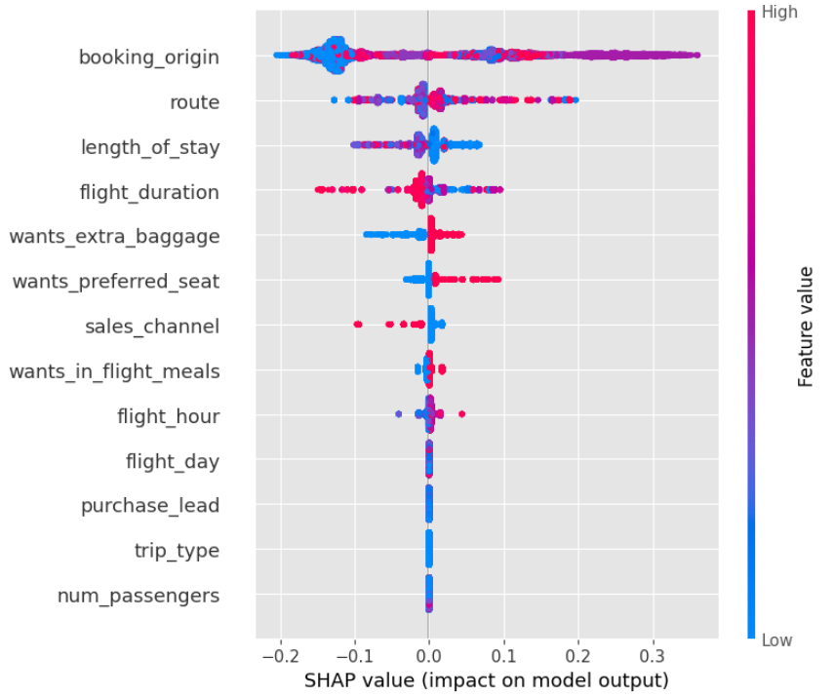
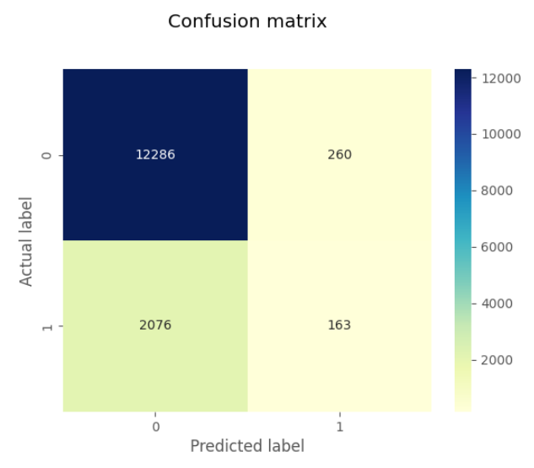
Customer Booking Data Machine Learning Model Findings:
Model Accuracy: 85%

